Slide 1
CS5412:
VIRTUAL SYNCHRONY
CS5412 Spring 2015 (Cloud Computing: Birman)
Lecture XIV
Ken Birman

Slide 2
Group Communication idea
System supports a new abstraction (like an object)
  A “group” consisting of a set of processes (“members”) that join, leave and cooperate to replicate data or do parallel processing tasks
  A group has a name (like a filename)
  … and a state (the data that its members are maintaining)
    The state will often be replicated so each member has a copy
    Note that this is in contrast to Paxos where each member has a partial copy and we need to use a “learner algorithm” to extract the actual current state
    Think of state much as you think of the value of a variable, except that a group could track many variables at once
CS5412 Spring 2015 (Cloud Computing: Birman)

Slide 3
Group communication Idea
The members can send each other
  Point-to-point messages
  Multicasts that go from someone to all the members
They can also do RPC style queries
  Query a single member
  Query the whole group, with all of them replying
Example: The Isis² system (but there are many such systems)
CS5412 Spring 2015 (Cloud Computing: Birman)

Slide 4
Animation: A process joins a group
S starts by creating an endpoint object, attaching upcall handlers to (later) react to events like membership changes and multicasts reporting updates
At first, P is just a normal program, with purely local private variables
P still has its own private variables, but now it is able to keep them aligned with track the versions at Q, R and S
Once the group endpoint is properly configured, S issues a “join” request. Isis² checks to see if the group already exists. If not, p can create a new instance, but in this case, the group is already active.
P
Q
R
S
P
Q
R
Initial state
S
CS5412 Spring 2015 (Cloud Computing: Birman)

Slide 5
P’s endpoint
Just an object that is P’s “portal” for operations involving the group
The endpoint lets P see events occurring in the group such as members joining, failing (detected slowly via timeout) or leaving (very fast notification), multicasts reporting updates or other events, queries, etc
But no data is automatically replicated. P provides logic to maintain the data it associates with the group.
CS5412 Spring 2015 (Cloud Computing: Birman)

Slide 6
Isis² is a library for group communication
Formal model permits us to achieve correctness
Isis² is too complex to use formal methods as a development tool, but does facilitate debugging (model checking)
Think of Isis² as a collection of modules, each with rigorously stated properties

Slide 8
Isis² makes developer’s life easier
Group g = new Group(“myGroup”);
Dictionary <string,double> Values = new Dictionary<string,double>();
g.ViewHandlers += delegate(View v) {
  Console.Title = “myGroup members: “+v.members;
};
g.Handlers[UPDATE] += delegate(string s, double v) {
Values[s] = v;
};
g.Handlers[LOOKUP] += delegate(string s) {
g.Reply(Values[s]);
};
g.Join();
g.OrderedSend(UPDATE, “Harry”, 20.75);
List<double> resultlist = new List<double>();
nr = g.Query(ALL, LOOKUP, “Harry”, EOL, resultlist);
First sets up group
Join makes this entity a member. State transfer isn’t shown
Then can multicast, query. Runtime callbacks to the “delegates” as events arrive
Easy to request security (g.SetSecure), persistence
“Consistency” model dictates the ordering seen for event upcalls and the assumptions user can make. User can tell Isis2 how strong ordering needs to be.
CS5412 Spring 2015 (Cloud Computing: Birman)

Slide 9
Isis² makes developer’s life easier
Group g = new Group(“myGroup”);
Dictionary <string,double> Values = new Dictionary<string,double>();
g.ViewHandlers += delegate(View v) {
  Console.Title = “myGroup members: “+v.members;
};
g.Handlers[UPDATE] += delegate(string s, double v) {
Values[s] = v;
};
g.Handlers[LOOKUP] += delegate(string s) {
g.Reply(Values[s]);
};
g.Join();
g.OrderedSend(UPDATE, “Harry”, 20.75);
List<double> resultlist = new List<double>();
nr = g.Query(ALL, LOOKUP, “Harry”, EOL, resultlist);
First sets up group
Join makes this a member. State transfer isn’t shown
Then can multicast, query. Runtime callbacks to the “delegates” as events arrive
Easy to request security (g.SetSecure), persistence
“Consistency” model dictates the ordering seen for event upcalls and the assumptions user can make. User can tell Isis2 how strong ordering needs to be.
CS5412 Spring 2015 (Cloud Computing: Birman)

Slide 10
Isis² makes developer’s life easier
Group g = new Group(“myGroup”);
Dictionary <string,double> Values = new Dictionary<string,double>();
g.ViewHandlers += delegate(View v) {
  Console.Title = “myGroup members: “+v.members;
};
g.Handlers[UPDATE] += delegate(string s, double v) {
Values[s] = v;
};
g.Handlers[LOOKUP] += delegate(string s) {
g.Reply(Values[s]);
};
g.Join();
g.OrderedSend(UPDATE, “Harry”, 20.75);
List<double> resultlist = new List<double>();
nr = g.Query(ALL, LOOKUP, “Harry”, EOL, resultlist);
First sets up group
Join makes this entity a member. State transfer isn’t shown
Then can multicast, query. Runtime callbacks to the “delegates” as events arrive
Easy to request security (g.SetSecure), persistence
“Consistency” model dictates the ordering seen for event upcalls and the assumptions user can make. User can tell Isis2 how strong ordering needs to be.
CS5412 Spring 2015 (Cloud Computing: Birman)

Slide 12
Isis² makes developer’s life easier
Group g = new Group(“myGroup”);
Dictionary <string,double> Values = new Dictionary<string,double>();
g.ViewHandlers += delegate(View v) {
  Console.Title = “myGroup members: “+v.members;
};
g.Handlers[UPDATE] += delegate(string s, double v) {
Values[s] = v;
};
g.Handlers[LOOKUP] += delegate(string s) {
g.Reply(Values[s]);
};
g.Join();
g.SetSecure(key);
g.OrderedSend(UPDATE, “Harry”, 20.75);
List<double> resultlist = new List<double>();
nr = g.Query(ALL, LOOKUP, “Harry”, EOL, resultlist);
First sets up group
Join makes this entity a member. State transfer isn’t shown
Then can multicast, query. Runtime callbacks to the “delegates” as events arrive
Easy to request security (g.SetSecure), persistence
“Consistency” model dictates the ordering seen for event upcalls and the assumptions user can make. User can tell Isis² how strong ordering needs to be.
CS5412 Spring 2015 (Cloud Computing: Birman)

Slide 13
Isis² makes developer’s life easier
Group g = new Group(“myGroup”);
Dictionary <string,double> Values = new Dictionary<string,double>();
g.ViewHandlers += delegate(View v) {
  Console.Title = “myGroup members: “+v.members;
};
g.Handlers[UPDATE] += delegate(string s, double v) {
Values[s] = v;
};
g.Handlers[LOOKUP] += delegate(string s) {
g.Reply(Values[s]);
};
g.Join();
g.SetSecure(key);
g.Send(UPDATE, “Harry”, 20.75);
List<double> resultlist = new List<double>();
nr = g.Query(ALL, LOOKUP, “Harry”, EOL, resultlist);
First sets up group
Join makes this entity a member. State transfer isn’t shown
Then can multicast, query. Runtime callbacks to the “delegates” as events arrive
Easy to request security (g.SetSecure), persistence
“Consistency” model dictates the ordering seen for event upcalls and the assumptions user can make. User can tell Isis² how strong ordering needs to be.
CS5412 Spring 2015 (Cloud Computing: Birman)

Slide 14
Concept: Query as a “multi-RPC”
One member asks multiple group members to perform some action
It could be doing this on behalf of an external client, and it might participate too
Often group members subdivide the task (but there could be a fault-tolerance benefit to asking 2 or more to do the same work)
p q r s
CS5412 Spring 2015 (Cloud Computing: Birman)

Slide 17
Clients of a group
Applications linked to Isis² can access a group by joining it as a member, but can also issue requests as a “client” in RPC style
One can also build a group that uses a web service standard (SOAP, WCF, REST) to accept requests from web clients that don’t use Isis² at all. Many cloud services can automatically load balance such requests over the set of group members.
The representative acts as a “proxy” for the client and can issue multicasts or queries on its behalf
CS5412 Spring 2015 (Cloud Computing: Birman)

Slide 18
Concepts
You build your program and link with Isis²
It starts the library (the new guy tracks down any active existing members)
Then you can create and join groups, receive a “state transfer” to catch up, cooperate with others
All kinds of events are reported via upcalls
  New view: View object tells members what happened
  Incoming message: data fields extracted and passed as values to your handler method
CS5412 Spring 2015 (Cloud Computing: Birman)

Slide 19
Recipe for a group communication system
Bake one pie shell
  Build a service that can track group membership and report “view changes”
Prepare 2 cups of basic pie filling
  Develop a simple fault-tolerant multicast protocol
Add flavoring of your choice
  Extend the multicast protocol to provide desired delivery ordering guarantees
Fill pie shell, chill, and serve
  Design an end-user “API” or “toolkit”. Clients will “serve themselves”, with various goals…
CS5412 Spring 2015 (Cloud Computing: Birman)

Slide 20
Role of GMS
We’ll add a new system service to our distributed system, like the Internet DNS but with a new role
  Its job is to track membership of groups
  To join a group a process will ask the GMS
  The GMS will also monitor members and can use this to drop them from a group
  And it will report membership changes
CS5412 Spring 2015 (Cloud Computing: Birman)

Slide 21
Group picture… with GMS
p
q
r
s
t
u
GMS

Slide 22
Group membership service
Runs on some sensible place, like the first few machines that start up when you launch Isis²
Takes as input:
  Process “join” events
  Process “leave” events
  Apparent failures
Output:
  Membership views for group(s) to which those processes belong
  Seen by the protocol “library” that the group members are using for communication support
CS5412 Spring 2015 (Cloud Computing: Birman)

Slide 23
Issues?
The service itself needs to be fault-tolerant
  Otherwise our entire system could be crippled by a single failure!
So we’ll run two or three copies of it
  Hence Group Membership Service (GMS) must run some form of protocol (GMP)
CS5412 Spring 2015 (Cloud Computing: Birman)

Slide 24
Group picture… with GMS
p
q
r
s
t
GMS
CS5412 Spring 2015 (Cloud Computing: Birman)

Slide 25
Group picture… with GMS
p
Let’s start by focusing on how GMS tracks its own membership. Since it can’t just ask the GMS to do this it needs to have a special protocol for this purpose. But only the GMS runs this special protocol, since other processes just rely on the GMS to do this job
q
r
s
t
In fact it will end up using those reliable multicast protocols to replicate membership information for other groups that rely on it
GMS₀
GMS₁
GMS₂

Slide 28
Failure detection: may make mistakes
Recall that failures are hard to distinguish from network delay
  So we accept risk of mistake
  If p is running a protocol to exclude q because “q has failed”, all processes that hear from p will cut channels to q
    Avoids “messages from the dead”
  q must rejoin to participate in GMS again
CS5412 Spring 2015 (Cloud Computing: Birman)

Slide 29
Basic GMS
Someone reports that “q has failed”
Leader (process p) runs a 2-phase commit protocol
  Announces a “proposed new GMS view”
    Excludes q, or might add some members who are joining, or could do both at once
  Waits until a majority of members of current view have voted “ok”
  Then commits the change
CS5412 Spring 2015 (Cloud Computing: Birman)

Slide 30
GMS example
The GMS group
Proposed V₁ = {p,r}
Commit V₁
p
q
r
OK
V₀ = {p,q,r}
V₁ = {p,r}
Proposes new view: {p,r} [-q]: “p and r; q has left”
Needs majority consent: p itself, plus one more (“current” view had 3 members)
Can add members at the same time
CS5412 Spring 2015 (Cloud Computing: Birman)

Slide 31
Special concerns?
What if someone doesn’t respond?
  P can tolerate failures of a minority of members of the current view
    New first-round “overlaps” its commit:
      “Commit that q has left. Propose add s and drop r”
  P must wait if it can’t contact a majority
    Avoids risk of partitioning
CS5412 Spring 2015 (Cloud Computing: Birman)

Slide 32
What if leader fails?
Here we do a 3-phase protocol
  New leader identifies itself based on age ranking (oldest surviving process)
  It runs an inquiry phase
    “The adored leader has died. Did he say anything to you before passing away?”
    Note that this causes participants to cut connections to the adored previous leader
  Then run normal 2-phase protocol but “terminate” any interrupted view changes leader had initiated
CS5412 Spring 2015 (Cloud Computing: Birman)

Slide 33
GMS example
The GMS group
p
q
Inquire [-p]
Proposed V₁ = {q,r}[-p]
Commit V₁
r
OK: nothing was pending
OK
V₀ = {p,q,r}
V₁ = {q,r}[-p]
New leader first sends an inquiry
Then proposes new view: {q,r} [-p]
Needs majority consent: q itself, plus one more (“current” view had 3 members)
Again, can add members at the same time
CS5412 Spring 2015 (Cloud Computing: Birman)

Slide 34
Properties of GMS
We end up with a single service shared by the entire system
  In fact every process can participate
  But more often we just designate a few processes and they run the GMS
Typically the GMS runs the GMP and also uses replicated data to track membership of other groups
CS5412 Spring 2015 (Cloud Computing: Birman)

Slide 35
Use of GMS
A process t, not in the GMS, wants to join group “Upson309_status”
  It sends a request to the GMS
  GMS updates the “membership of group Upson309_status” to add t
  Reports the new view to the current members of the group, and to t
  Begins to monitor t’s health
CS5412 Spring 2015 (Cloud Computing: Birman)

Slide 36
Processes t and u “using” a GMS
The GMS group
p
q
r
s
t
u
The GMS contains p, q, r (and later, s)
Processes t and u want to form some other group, but use the GMS to manage membership on their behalf
CS5412 Spring 2015 (Cloud Computing: Birman)

Slide 37
Relate to Paxos
In fact we’re doing something very similar to Paxos
  The “slot number” is the “view number”
  And the “ballot” is the current proposal for what the next view should be
  With Paxos proposers can actually talk about multiple future slots/commands (concurrency parameter α)
  With GMS, we do that too!
    A single proposal can actually propose multiple changes
    First [add X], then [drop Y and Z], then [add A, B and C]…
    In order… eventually 2PC succeeds and they all commit
CS5412 Spring 2015 (Cloud Computing: Birman)

Slide 38
How does this differ from Paxos?
Details are clearly not identical, and GMS state isn’t durable
Runs with a well-defined leader; Paxos didn’t need one (in Paxos we often prefer to have a single leader but correctness is ensured with multiple coordinators)
Very similar guarantees of ordering and if we added logging, durability too. (Isis² SafeSend adds this logging)
Isis GMS protocol predates Paxos. It “bisimulates” Paxos, meaning that each can simulate the other.
CS5412 Spring 2015 (Cloud Computing: Birman)

Slide 39
We have our pie shell
Now we’ve got a group membership service that reports identical views to all members, tracks health
Can we build a reliable multicast?
CS5412 Spring 2015 (Cloud Computing: Birman)

Slide 40
Unreliable multicast
Suppose that to send a multicast, a process just uses an unreliable protocol
  Perhaps IP multicast
  Perhaps UDP point-to-point
  Perhaps TCP
… some messages might get dropped. If so it eventually finds out and resends them (various options for how to do it)
CS5412 Spring 2015 (Cloud Computing: Birman)

Slide 41
Concerns if sender crashes
Perhaps it sent some message and only one process has seen it
We would prefer to ensure that
  All receivers, in “current view”
  Receive any messages that any receiver receives (unless the sender and all receivers crash, erasing evidence…)
CS5412 Spring 2015 (Cloud Computing: Birman)

Slide 42
An interrupted multicast
p
q
r
s
A message from q to r was “dropped”
Since q has crashed, it won’t be resent
CS5412 Spring 2015 (Cloud Computing: Birman)

Slide 43
Terminating an interrupted multicast
We say that a message is unstable if some receiver has it but (perhaps) others don’t
  For example, q’s message is unstable at process r
If q fails we want to terminate unstable messages
  Finish delivering them (without duplicate deliveries)
  Masks the fact that the multicast wasn’t reliable and that the leader crashed before finishing up
CS5412 Spring 2015 (Cloud Computing: Birman)

Slide 44
How to do this?
Easy solution: all-to-all echo
  When a new view is reported
  All processes echo any unstable messages on all channels on which they haven’t received a copy of those messages
A flurry of O(n²) messages
Note: must do this for all messages, not just those from the failed process. This is because more failures could happen in future
CS5412 Spring 2015 (Cloud Computing: Birman)

Slide 45
An interrupted multicast
First an “internal” view shows up, triggers a flush
p
q
r
s
p had an unstable message, so it echoed it when it saw the new view
CS5412 Spring 2015 (Cloud Computing: Birman)

Slide 48
State transfer and reliable multicast
p
q
r
s
After re-ordering, it looks like each multicast is reliably delivered in the same view at each receiver
Note: if sender and all receivers fails, unstable message can be “erased” even after delivery to an application
  This is a price we pay to gain higher speed
CS5412 Spring 2015 (Cloud Computing: Birman)

Slide 49
What about ordering?
It is trivial to make our protocol FIFO wrt other messages from same sender
  If we just number messages from each sender, they will “stay” in order
Concurrent messages are unordered
  If sent by different senders, messages can be delivered in different orders at different receivers
This is the protocol called “Send”
CS5412 Spring 2015 (Cloud Computing: Birman)

Slide 50
When is Send used?
The protocol is very fast
  Useful if ordering really doesn’t matter
  Or if all the updates to some object are sent by the same process. In this case FIFO is what we need
Send is not the right choice if multiple members send concurrent, conflicting updates
  In that case use g.OrderedSend()
CS5412 Spring 2015 (Cloud Computing: Birman)

Slide 51
Other options?
OrderedSend: used if there might be concurrent sends
SafeSend: Most conservative but also quite costly. A version of Paxos (topic of next lecture)
CS5412 Spring 2015 (Cloud Computing: Birman)

Slide 52
What does this give us?
A second way to implement state machine replication in which each member has a complete and correct state
  Notice contrast with Paxos where to learn the state you need to run a decision process that reads Q_{R} copies
  Isis² replica is just a local object and you use it like any other object (with locking to prevent concurrent update)
  Paxos has replicated state but you need to read multiple process states to figure out the value
This makes Isis² faster and cheaper
CS5412 Spring 2015 (Cloud Computing: Birman)

Slide 53
Isis² versus Paxos
Isis² offers control over message ordering and durability. Paxos has just one option.
By default, Isis² is a multicast layer that just delivers messages and doesn’t log them
But you can log group states in various ways, including exactly what Paxos does.
CS5412 Spring 2015 (Cloud Computing: Birman)

Slide 54
How can Isis² offer Paxos?
Via the SafeSend API mentioned last time
  SafeSend is a genuine Paxos implementation
  But it does have some optimizations
  And it has an unlogged mode. For Paxos durability you need to enable the logged feature.
In normal Paxos we don’t have a GMS
  With a GMS the protocol simplifies slightly and we can relax the quorum rules
  SafeSend includes these performance enhancements but they don’t impact the correctness or properties of sol’n
CS5412 Spring 2015 (Cloud Computing: Birman)

Slide 55
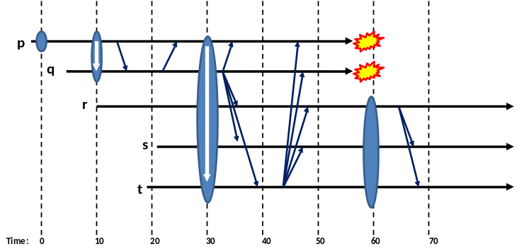
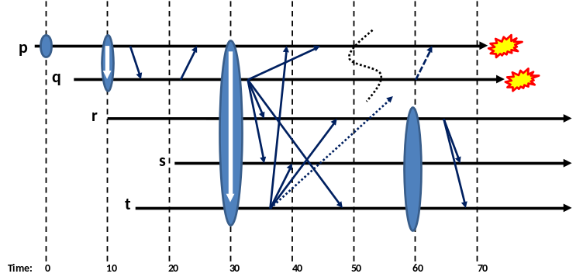
Consistency model: Virtual synchrony meets Paxos (and they live happily ever after…)
Synchronous execution
Virtually synchronous execution
Virtual synchrony is a “consistency” model:
  Synchronous runs: indistinguishable from non-replicated object that saw the same updates (like Paxos)
  Virtually synchronous runs are indistinguishable from synchronous runs

Slide 58
State transfer worry
If my database is just a few Mbytes… just send it
But in the cloud we often see databases with tens of Gbytes of content!
Copying them will be a very costly undertaking
CS5412 Spring 2015 (Cloud Computing: Birman)

Slide 59
Out-of-Band (OOB) technology
Allows copying big state by replication of memory-mapped files, very efficient
There is a clever way to integrate OOB transfers with state transfer
Effect is that with a bit more effort, Isis² won’t need to send big objects through its multicast layer
CS5412 Spring 2015 (Cloud Computing: Birman)

Slide 60
Isis² DHT
The system also has a fancy key-value store
  Runs in a group and shards the data
  One-hop get and put: no indirect routing needed!
  Can even put or get multiple key-value pairs at a time, and there is a way to request totally ordered, consistent get and put: gives a form of atomicity
Then you can do “aggregated query” operations to leverage the resulting parallel computing opportunity
CS5412 Spring 2015 (Cloud Computing: Birman)

Slide 61
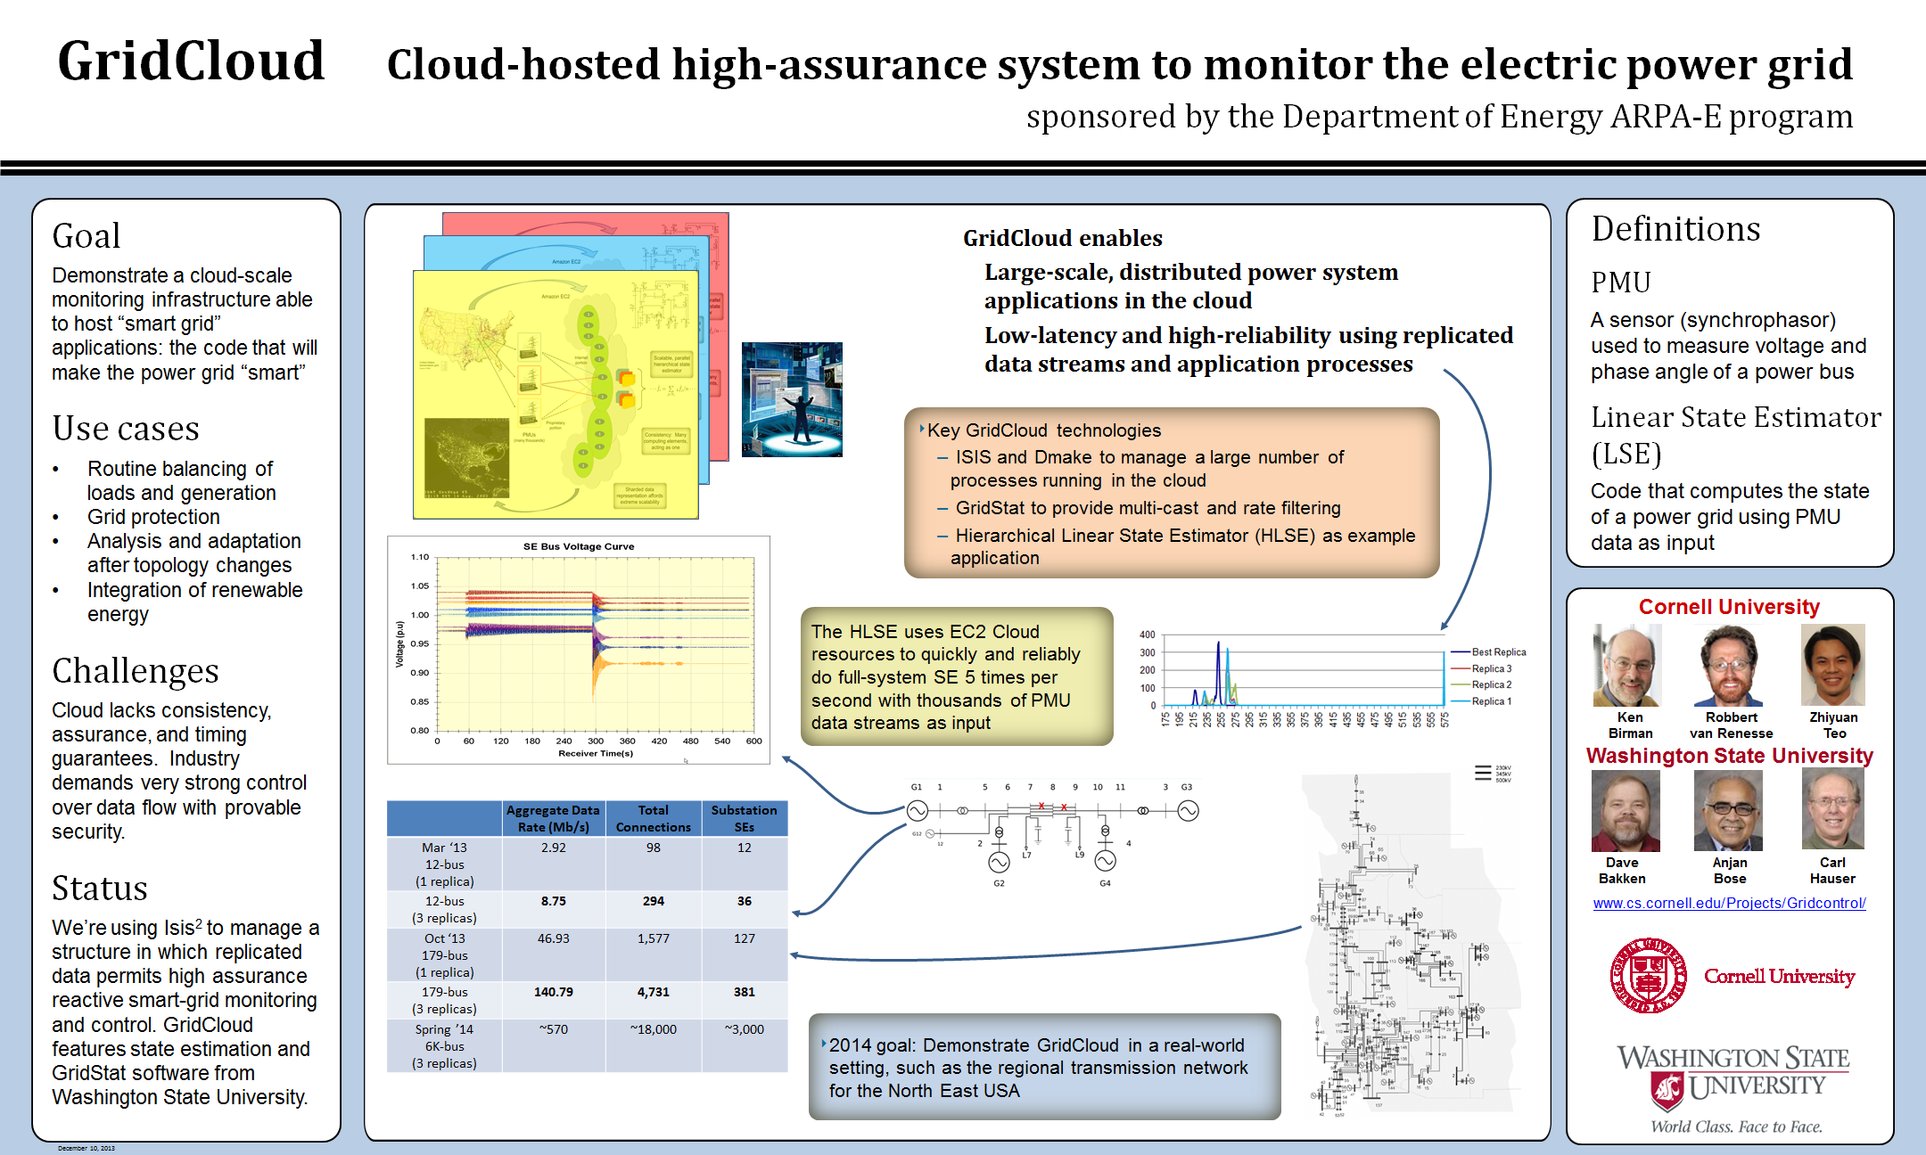
GridCloud: Example Isis² application
CS5412 Spring 2015 (Cloud Computing: Birman)

Slide 62
Summary
Group communication offers a nice way to replicate an application
  Replicated data (without the cost of quorums)
  Coordinated and replicated processing of requests
  Automatic leader election, member ranking
  Automated failure handling, help getting external database caught up after a crash
  Tools for security and other aspects that can be pretty hard to implement by hand
CS5412 Spring 2015 (Cloud Computing: Birman)

